Slide 1
INTERNSHIP PROJECT
Team ID: LTVIP2025TMID35183
TEAM:
Mada Akhila
Kaja Likhitha
Lanka Nandini
Dandugula Lalitha

Slide 2
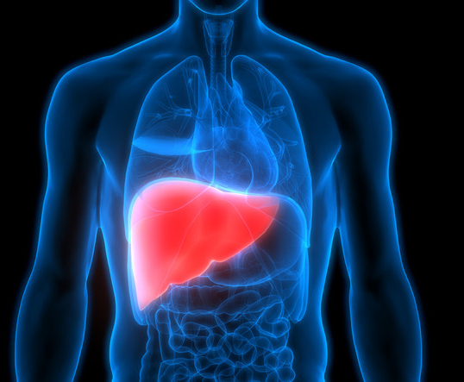
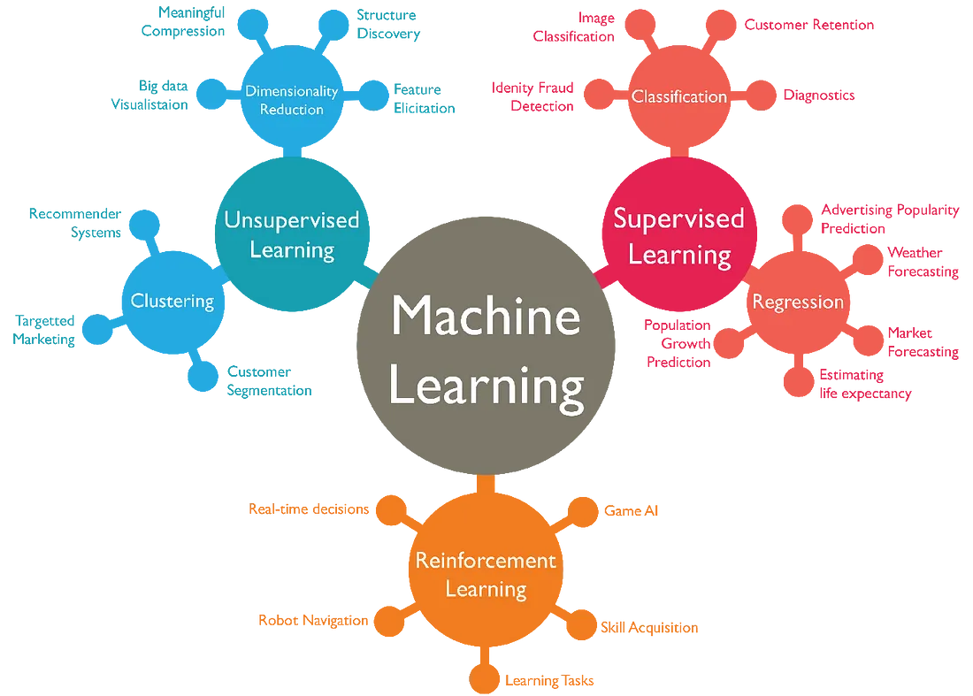
Title: Predicting Liver Cirrhosis Using Advanced Machine Learning Techniques
Subtitle: A Comprehensive Data-Driven Approach for Early Detection and Intervention

Slide 3
Phase-1: Brainstorming & Ideation
What is Liver Cirrhosis?
Why Early Prediction?
Chronic liver disease leading to scarring (fibrosis)
Causes: Hepatitis, Alcohol abuse, Non-Alcoholic Fatty Liver Disease (NAFLD)
High morbidity and mortality rates worldwide
Early detection improves outcomes
Reduces the burden on healthcare systems
Enables timely intervention

Slide 4
PRODUCT OVERVIEW
Phase-1: Brainstorming & Ideation
Problem Statement:
Need for reliable non-invasive liver cirrhosis prediction tools
Challenges in Traditional Diagnosis:
Invasive methods like liver biopsy
Expensive imaging techniques
Late-stage detection is common

Slide 5


Phase-1: Brainstorming & Ideation
Objectives
Target Users
Develop machine learning models to predict liver cirrhosis.
Achieve high sensitivity to minimize false negatives.
Build an interpretable, deployable system for clinical settings
Primary Users: Hepatologists, Gastroenterologist, etc.
Secondary Users: Researchers, Pharmaceutical Professionals, etc.n

Slide 6
Phase-2: Technical and functional requirements
Technical requirements
EHRs, imaging data, laboratory results, other manual inputs etc .
Machine Learning Framework (TensorFlow, PyTorch)
Advanced algorithms, APIs, Front End: HTML-CSS
Functional Requirements
Data Collection, Data preprocessing, Model training, etc...
Constraints & Challenges
Medical data like blood reports, medical imaging data, Patient inputs etc
Data quality and availability
Model complexity and interpretability

Slide 7
Phase-2: Technical and functional requirements
Dataset Overview
Target Variable:
Age, Gender
Total Bilirubin
Direct Bilirubin
Alkaline Phosphatase (ALP)
SGPT / SGOT
Total Proteins
Albumin
Albumin/Globulin Ratio
Step-1
Liver Cirrhosis patient vs. Normal patient
Step-2
compensated vs decompensated cirrhosis

Slide 8
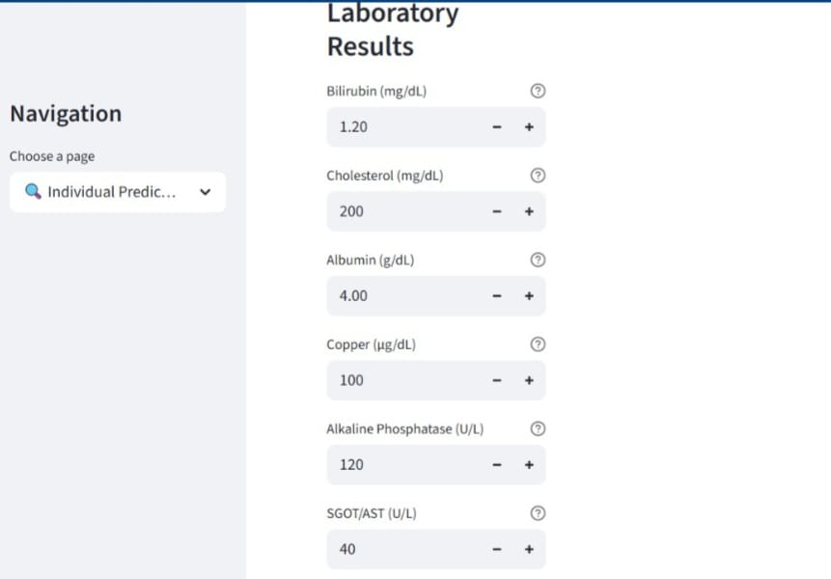
Phase-2: Technical and functional requirements
Dataset
Window

Slide 9
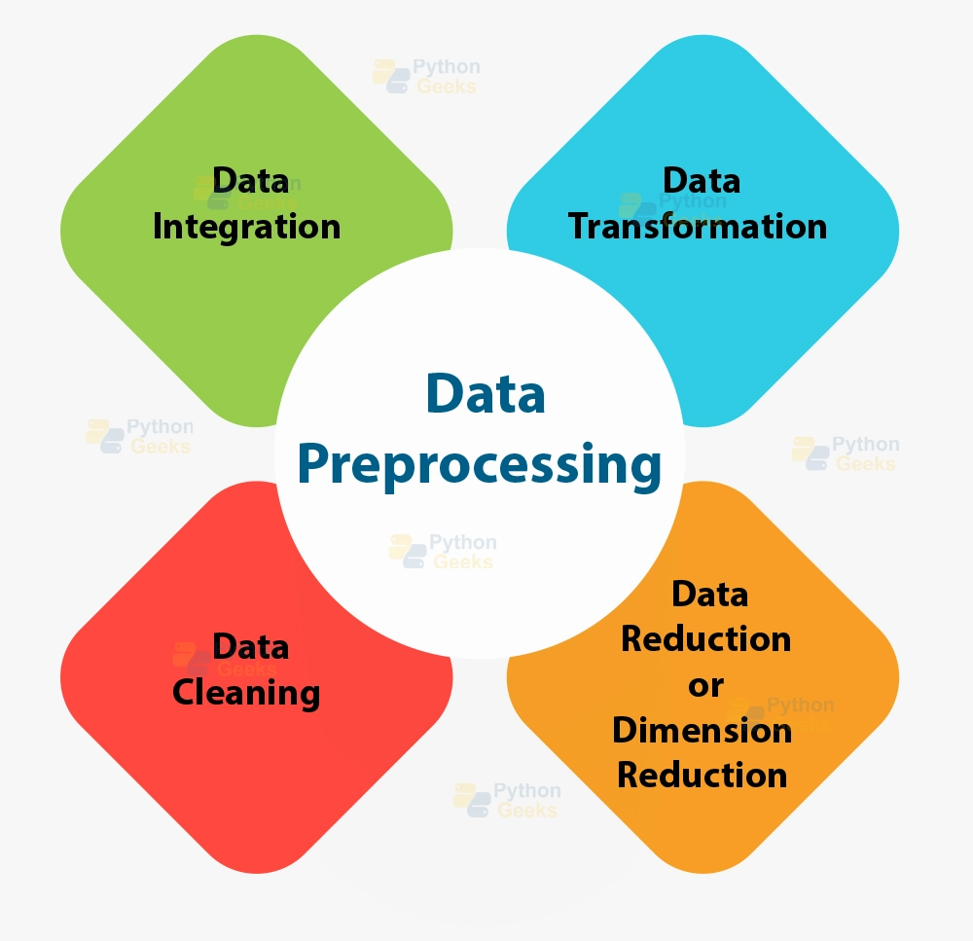
Phase-3: Project Design
Data Preprocessing
Steps
Handling missing values
Encoding categorical variables (e.g., Gender)
Outlier detection and removal in data sets
Feature scaling (Standardization/Normalization)

Slide 10
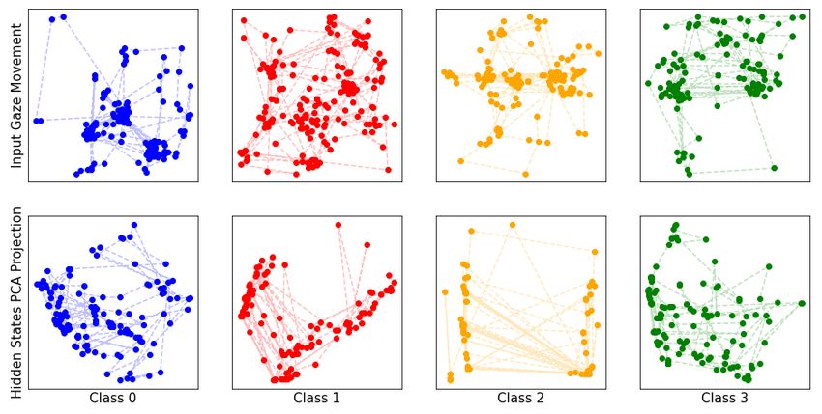
Phase-3: Project Design
Data Exploration
Visualizations:
Correlation Heatmap
Distribution plots
e.g., Bilirubin levels vs. diagnosis
Initial Insights:
AST and ALT are strong indicators.
Albumin / Globulin Ratio shows significant separation.

Slide 11
Machine Learning Models Applied
Phase-4: Project Development
Baseline Models:
Logistic Regression
Decision Trees
Advanced Models:
Random Forest
Neural Networks (MLP)

Slide 12
Evaluation Metrics
Phase-4: Project Development
Why Multiple Metrics Matter:
Accuracy: General correctness
Precision: Correctness of positives (False Positive impact)
Recall (Sensitivity): Correct detection of actual liver patients (critical in healthcare)
F1 Score: Balance between Precision and Recall
ROC-AUC: Model's ability to distinguish between classes

Slide 13
Model Performance Comparison
Phase-5: Functional & Performance Testing
Model | Accuracy | Precision | Recall | F1 Score | AUC-ROC
Logistic Regression | 78% | 0.81 | 0.75 | 0.78 | 0.82
Neural Network | 88% | 0.89 | 0.87 | 0.88 | 0.91

Slide 14
Phase-6: Conclusion
Limitations & Challenges
Data-related:
Model-related:
Small dataset size
Missing medical history or comorbidities
Risk of overfitting
Interpretability challenges in complex models

Slide 15
Conclusion
Phase-6: Conclusion
Key Takeaways:
Machine learning can significantly aid early liver cirrhosis detection.
Deployment-ready solutions are feasible but require careful validation

Slide 16
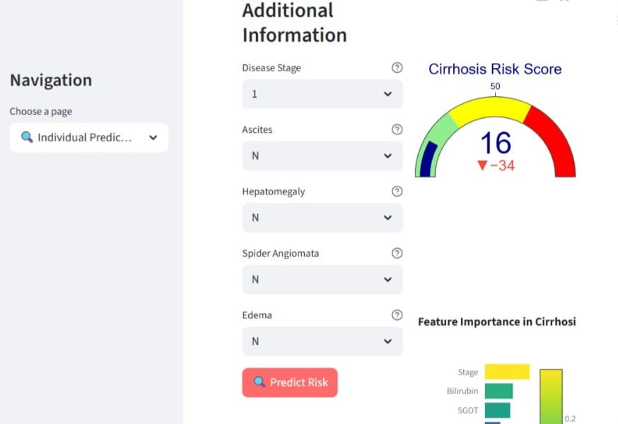
Phase-6: Conclusion
Front end

Slide 17
Future Work
Phase-7: Future Work
Accuracy: General correctness
Data Expansion: Multicenter datasets and large data sets
Model Improvements: Multimodal learning (lab + imaging + notes)
Clinical Implementation: Real-time decision support tools
Cloud-Based Infrastructure: Scalable, flexible, and accessible from anywhere.
Seamless API Integration: Enables interoperability with healthcare systems, EHRs, and third-party tools.
Enterprise-Grade Security: Ensures patient data privacy, and robust protection against cyber threats.

Slide 18
THANK YOU

